Slide 1

AI Startup Success Predictor
A Data-Driven Approach to Venture Capital Investment

Slide 2

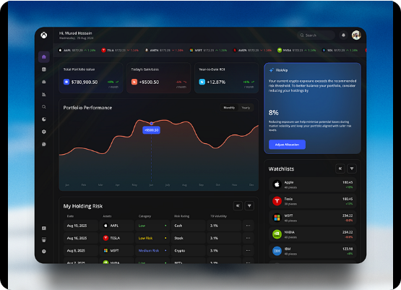
The Problem & Solution
•
The Challenge: High failure rates for startups in the first 5 years cause massive Venture Capital losses.
•
Traditional Methods: Investment decisions rely heavily on intuition and limited qualitative data.
•
Our Solution: An automated, AI-powered web application that predicts startup success based on historical metrics.
•
The Goal: Mitigate risks and enable data-driven, strategic investments.

Slide 3






Project Architecture
Data Processing
ML Modeling
Deployment
Extensive Exploratory Data Analysis, cleaning, handling missing values, and engineering lifecycle features like company age.
Evaluated multiple algorithms with rigorous hyperparameter tuning, focusing on F1-Score, Precision, and Recall.
Developed a seamless Streamlit application offering single predictions, bulk processing, and interactive dashboards.

Slide 4
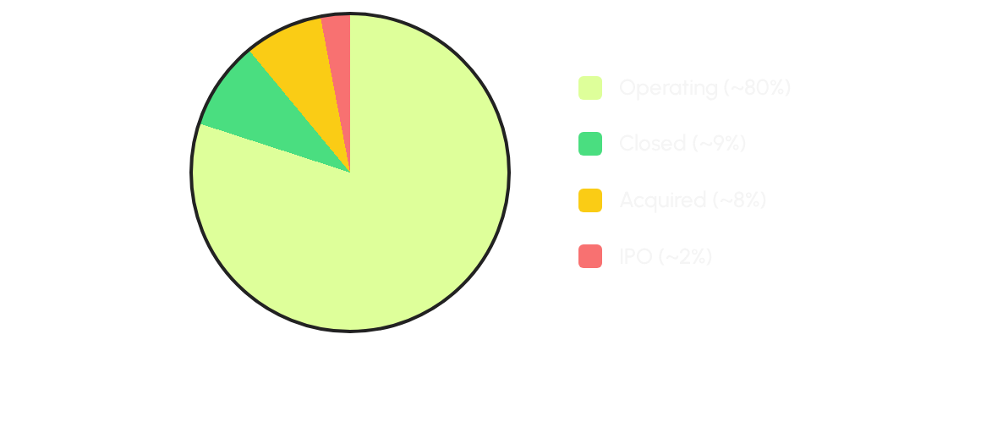
Target Variable Distribution
*The dataset is highly imbalanced, requiring careful evaluation metrics beyond standard accuracy.

Slide 5
Feature Engineering
Company Age: Calculated from the founding date to the present or closure. Critical indicator of market maturity.
Funding Duration: The time span between the first and last funding rounds, revealing sustained investor confidence.
Time to First Funding: Measures how quickly a startup secured its initial capital after founding.
Outlier Handling: Winsorization applied at the 1st and 95th percentiles to cap extreme values without data loss.

Slide 6
Model Evaluation
Algorithm | Accuracy | Precision | Recall | F1-Score
Gradient Boosting (Best) | 92.5% | 91.8% | 92.5% | 91.5%
Random Forest | 91.2% | 90.1% | 91.2% | 90.2%
AdaBoost | 89.4% | 88.5% | 89.4% | 88.6%
Logistic Regression | 85.1% | 83.2% | 85.1% | 83.5%

Slide 7
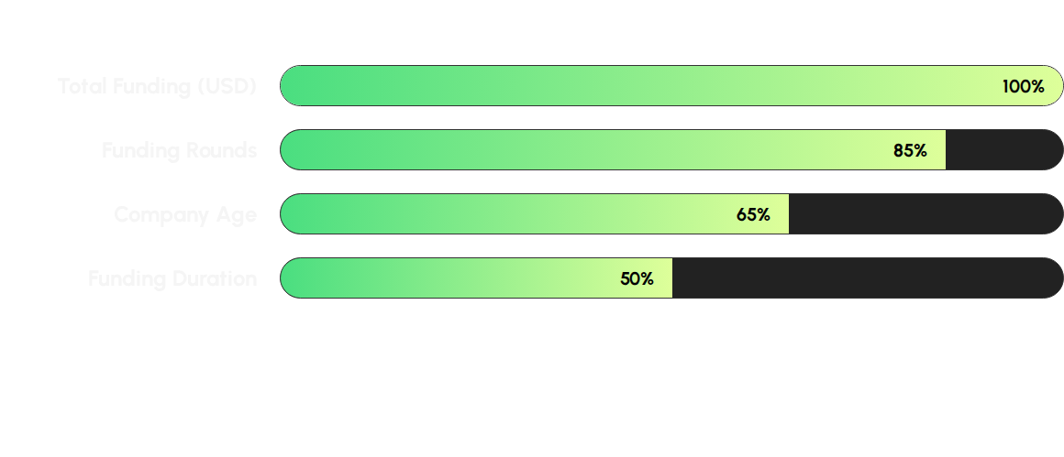
Feature Importance
*SHAP analysis revealed that sustained funding and rounds dictate model decisions more than a single massive seed round.

Slide 8
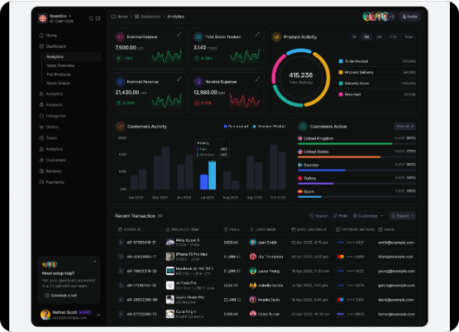
Interactive Application
•
Single Prediction: Instant success forecasting by manually inputting startup parameters.
•
Bulk Processing: VC analysts can upload CSV files to evaluate hundreds of startups simultaneously.
•
What-If Simulator: Real-time adjustments to funding rounds or age to visualize the impact on success probability.
•
Data Insights: Built-in dashboards to explore historical data and market trends.

Slide 9






Meet the Team
Ziad Bahaa
Mohamed Ahmed
Ahmed wagdy
Data & Engineering
Machine Learning
Deployment
Led Exploratory Data Analysis, cleaning, handling outliers, and engineering key timeline features.
Trained and optimized multiple models, achieving a 91.5% F1-Score using Gradient Boosting.
Developed the complete Streamlit web application with bulk prediction and what-if simulation features.

Slide 10
Questions & Answers
Ready to revolutionize your investment strategy?
Machine Learning for Data Science Team | Cretiva NTI

